Slide 1
DEPARTMENT OF ELECTRONICS AND COMMUNICATION ENGINEEIRNG
Private idea implementation
shreerecvidyam@4

Slide 2

ABSTRACT
shreerecvidyam@4
Cancer is a major cause of death worldwide, accounting for around 8 million deaths in 2022. Still now it continues to be a disease threat all around. In this regard, we take up the Brain tumours Detection as it is particularly difficult to detect, and early treatment is essential to avoid memory loss and potentially fatal outcomes. To address this challenge, we have developed a machine learning- based solution that leverages convolution neural networks (CNNs) for feature extraction, segmentation, and pre-processing of magnetic resonance images to detect brain tumours with high accuracy. We obtained our dataset from a reliable internet source, and our results indicate that our approach can accurately detect brain tumour conditions, enabling prompt and effective treatment and leading to better recovery rates. Our project offers a promising solution to the need for improved brain tumour detection methods.
Private idea implementation
shreerecvidyam@4
shreerecvidyam@4

Slide 3

INTRODUCTION
This project has discussed the different stages of brain tumours with a percentage impact of tumours. Image segmentation is a crucial and essential step in pre-processing of image that determines the success of image processing at a higher level. Cancer refers to cells being abnormal and growing in unnatural ways. Cerebrum Cancer division is a significant assignment in clinical picture handling. Medical imaging refers to a technique to diagnose or analyse the human body. In this case we have mainly focused on the detection of the brain tumour from the MRI images. It helps the medical representative to find the location of the tumour in the brain easily to analyse disease before further difficulties. Nowadays, checking the huge number of MRI (magnetic resonance imaging) images and finding a brain tumour manually by a human is a very tedious and inaccurate task. It can affect the proper medical treatment of the patient. . So, there is a need for a highly accurate tumour detection method. Accuracy is crucial in healthcare intelligent systems, and to address this issue, a highly accurate model has been developed for automated brain tumour detection. This model utilizes advanced image processing techniques to detect brain tumours from MRI images, reducing the risk of human error and improving overall clinical outcomes.
Private idea implementation
shreerecvidyam@4
shreerecvidyam@4

Slide 4

LITERATURE REVIEW
The Fuzzy segmentation method (FCM) was applied to separate tumour and non-tumour regions of the brain. Finally, deep neural networks (DNNs) were incorporated to classify brain tumours with high accuracy, but the complexity was very high and the code run performance was very poor. A new model of tumour growth was presented for step-by- step analysis of patient tumour growth. These proposed schemes provide the possibility of error causing detection. This technique was mostly used to segment brain tissue, but the computation time was high. A new method of segmenting granular tumours using the Cellular Automata (CA) technique was presented, which is compared with the histogram-based segmentation method. Seed selection and volume of interest (VOI) were calculated for efficient segmentation of brain tumours. Segmentation of tumour sections was also incorporated into this work. Thus, the complexity was less but the accuracy was also less. A brain tumour segmentation method, also known as multimodal brain tumour segmentation diagram was introduced. Also, it combined different segmentation algorithms to achieve high performance compared to the existing method. But the complexity was high. With reference to all these, we have updated to the latest version of a code with accuracy in optimum level.

Slide 5

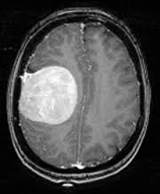
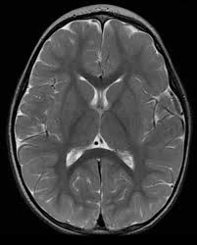
PROPOSED METHOD
shreerecvidyam@4
To solve this problem, we are using TensorFlow and Keras image pre-processing modules using these 2 as the base for training the modules we feed them with data of brain tumour (Classes of Yes, No). Then we save the training model to maintain the accuracy and reduce the runtime for later processes
NUMBER OF IMAGES
FOLDER DIRECTORY
Set of images
253
Total
98
No Tumour
155
Tumour
Yes
No
Private idea implementation
shreerecvidyam@4

Slide 6

METHODOLOGIES
shreerecvidyam@4
This section covers the fundamental techniques utilized in constructing the model, including the use of Convolution Neural Networks (CNN), Keras of, and TensorFlow. In CNN we have used a function known as Binary Cross Entropy Loss Function, it is a model metric that tracks incorrect labeling of the data class by a model, penalizing the model if deviations in probability occur into classifying the labels. Low log loss values equate to high accuracy values. We have also used ModelCheckpoint callback, which is used to save the current state of the trained model or so that the modal can be loaded form the last saved state. They are snapshots of our working model during the training process and stores it in a non-volatile memory
Private idea implementation
shreerecvidyam@4

Slide 7





SYSTEM SPECIFICATION
Keras version 2
Keras version 2 is a popular open-source deep learning library that provides a high-level interface for building and training neural networks.
CNN model
CNN we have used a function known as Binary Cross Entropy Loss Function.
Tensorflow of version 2.x
Powerful and widely-used deep learning framework that enables researchers and developers to build, train, and deploy complex machine learning models efficiently.
Python 3.9.16
Python 3.9.16 includes various performance optimizations, such as faster dictionary operations and improved performance for built-in functions
shreerecvidyam@4

Slide 8

DATA SEGREGATION
Validation Data 10%
Test Data 5%
shreerecvidyam@4
Train Data 85%
Private idea implementation
shreerecvidyam@4

Slide 9

MIND MAP FOR PROPOSED SOLUTION
1
First, the required packages are imported.
The loss graph and the accuracy graph are plotted
10
Then the folder where the dataset is stored is imported.
2
9
Then the accuracy of the model is evaluated using the test images
3
Image reading is done after that it is labelled and then the images are stored in the data frame
8
The model compilation is completed
shreerecvidyam@4
The size of the image is changed to 224*224
4 7
The model compilation is completed
5
The data is split into 3:- Training, Validation, Test
6
Image normalization is completed.
Private idea implementation
shreerecvidyam@4

Slide 10

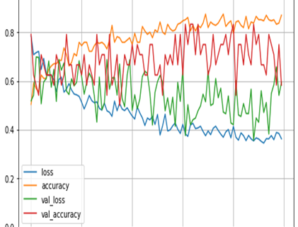
RESULT
When the model is applied to the testing data set for 100 epochs, an accuracy of 96.3% is obtained and the validation loss is also less.
CNN (Convolutional Neural Network) helps to predict just by reducing and resizing the image without losing any important information that will be used for predicting. The loss gradually starts decreasing with the increase in the number of epochs. The model loss is very less when applied to the training set whereas it is high when applied to the validation set.
shreerecvidyam@4
Private idea implementation
shreerecvidyam@4

Slide 11
THANK YOU
Private idea implementation
shreerecvidyam@4

